Slide 1
Why and how Integrated Care Systems should partner with the voluntary sector to tackle health inequalities
12 - 2pm, 22.03.22

Slide 2
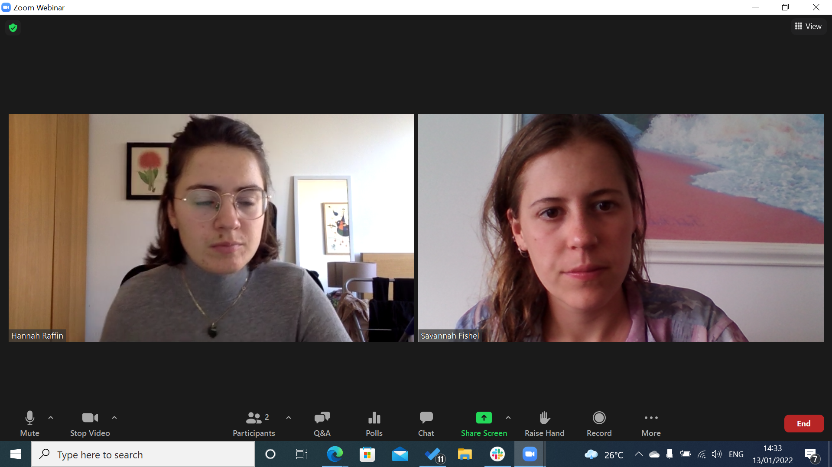
Zoom Webinar
Change your view here
Write and upvote questions here
Introduce yourself / contribute in chat
Contact Savannah Fishel in chat if you are having technical problems

Slide 3
Themes from the learning that emerged from the Health Equality Development Grantee learning and support programme
9 months
7 learning events
3 workshops
2 public-facing events
14 sites across England
Adapt the narrative and engagement strategy to different audiences.
Make expectations clear and explicit with partners from the start.
Structure is a vital enabler of strong partnership working.
Capitalise on the altered perception of the VCSE sector and its USP.
Influencing a complex system with moving parts takes time - and there are many approaches across different levels.
Partner with local, community-led organisations to build trust with citizens.
Focus on where the energy already is.
Relational and empathetic practice: trust first.
Visit innovationunit.org/projects/health-equalities/ for more information and resources.
Full storybook available for download from April.

Slide 5
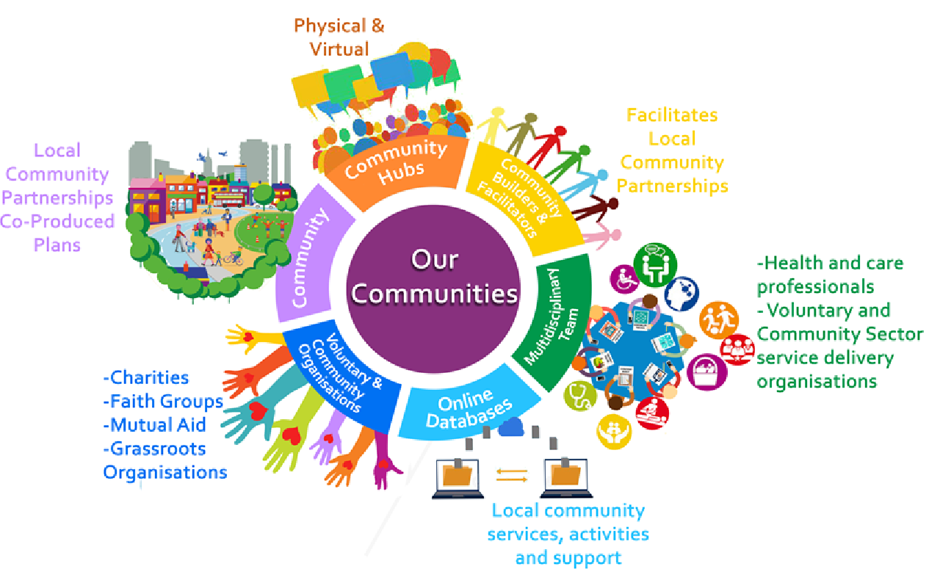
Healthy Communities Together
Healthy Communities Together

Slide 6
One Croydon Alliance
Six organisations: improve health and care outcomes, through integration
Original scope: ageing population
Now: whole population

Slide 7
Healthy Communities Together
Ambition - Strong partnership working between the voluntary and community sector (VCS), the NHS, and local authorities to improve the health and wellbeing of local communities in Croydon
Now, in Phase 2
Local Voluntary Partnerships Board
Empowerment and Engagement
Leadership and Representation
Funding and Commissioning
Shifting power and authority to local people & localities
New Locality Operating Model
At least 6 community hubs across
A stronger voice for all voluntary organisations in One Croydon.
Shared leadership model
Elected Chair
Shifting financial resources to the voluntary sector over time and commissioning for outcomes.
Locality-based commissioning model
£100m under review

Slide 8
Key challenges
Croydon Council cuts
Sustaining investment
Relationships
Time!

Slide 9
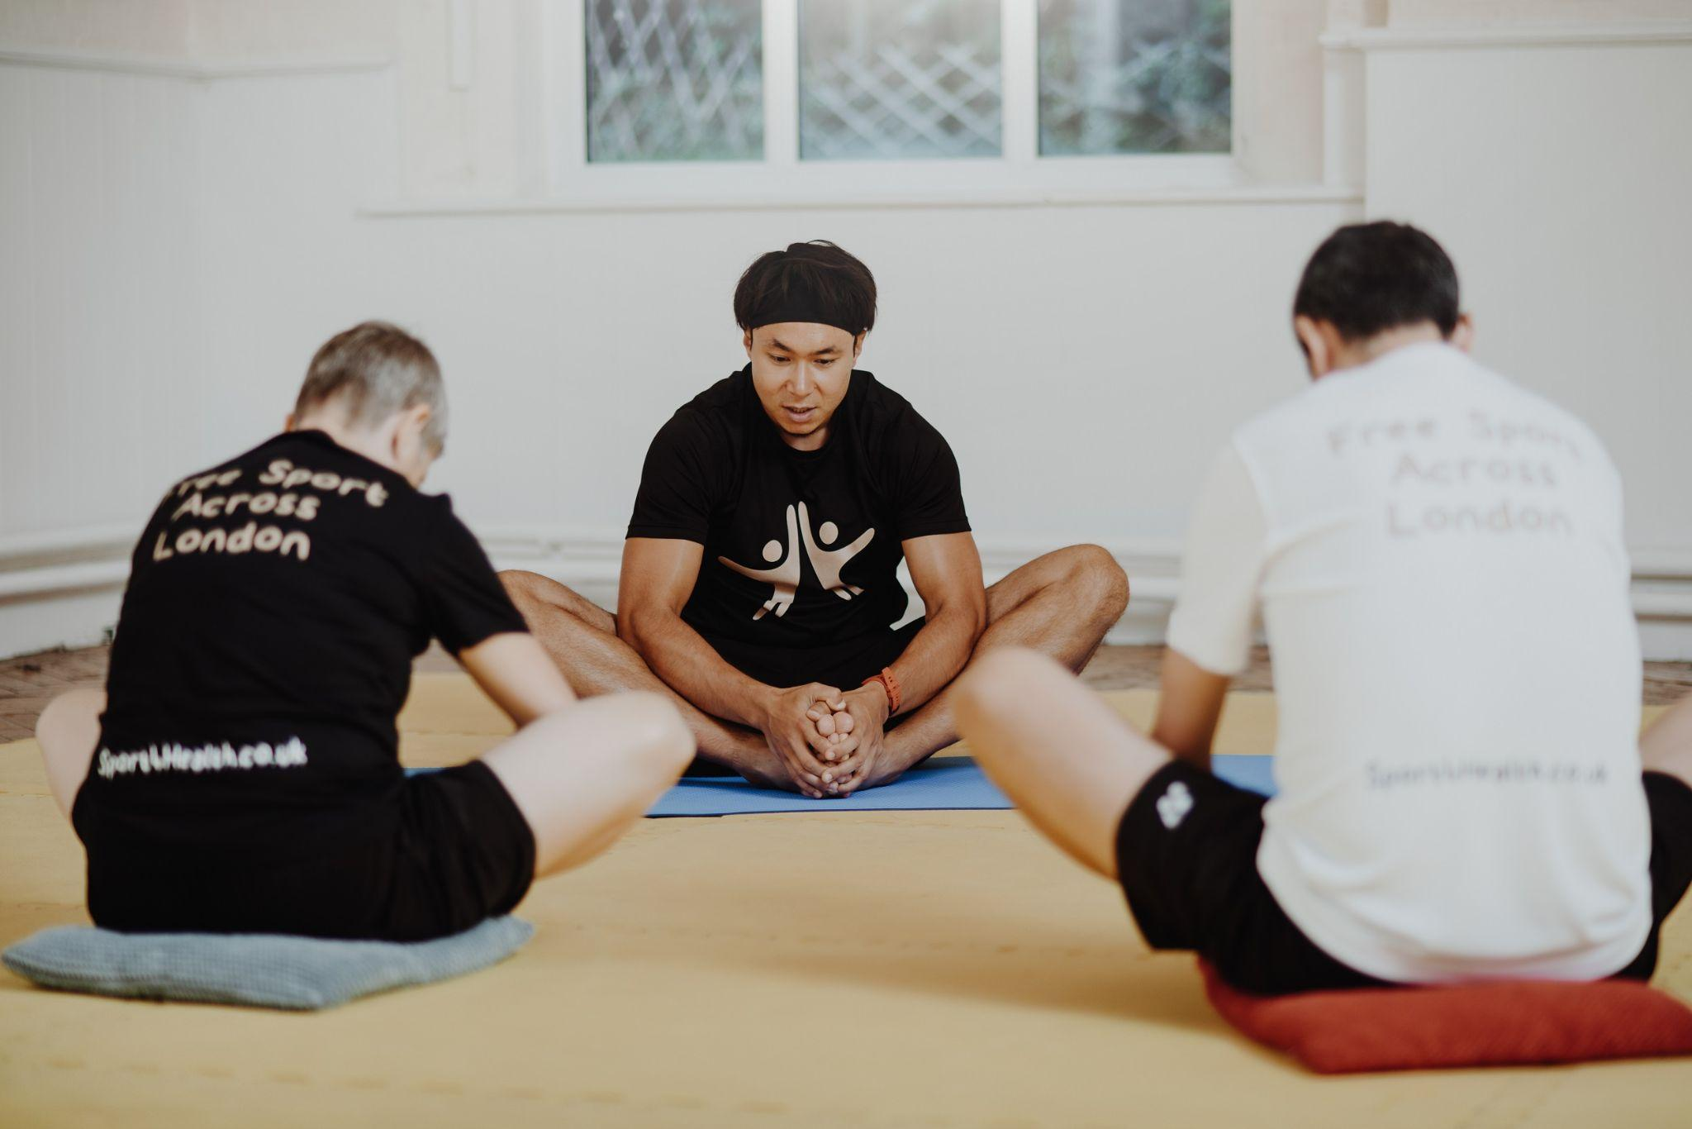
IVAR’s
programme: Connecting health communities
Image credit: Sport4Health

Slide 10
Connecting health communities
IVAR provides a facilitation support package to enable cross-sector partnerships across England to address health inequalities
Focus on health inequalities: Covid-19 has further exposed the health inequalities that exist across the UK.
Steering groups in areas with cross-sector representation support and lead the actions
Notes:
Connecting Health Communities (‘CHC’) is one of our three flagship programmes, focused on supporting the role and participation of local voluntary organisations and people with lived experience in cross-sector health and care partnerships. CHC builds on 15 years’ work on cross-sector partnership working.
What do we do?
We bring together local NHS structures like Integrated Care Systems (ICS) and Primary Care Networks (PCNs), the voluntary sector, communities facing health inequalities and local authority/ public health to work together on shared concerns.
Why health inequalities? Covid-19 highlighted the vulnerability and challenges experienced by groups experiencing racial injustice, those living in deprived areas, and people working in lower-paid professions.
How are we doing this? Our local area work is shaped and driven by steering groups with cross-sector representation, feeding into wider partnership sessions that bring together cross-sector stakeholders with local residents and community-based organisation to discuss and finalise ideas, and get actions going AND next slide please…

Slide 12
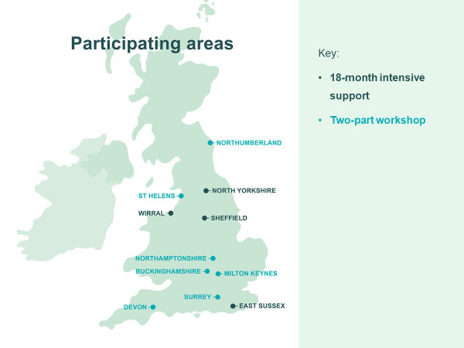

Slide 14
Setting up a Health and Wellbeing Alliance in Milton Keynes
Sonal Mehta, VCSE Partnership Lead, Bedfordshire, Luton & Milton Keynes ICS

Slide 15
MK Health Inequalities Action Group
Formed in response to Covid and concerns about vulnerable groups
Cross-sector membership
Using knowledge of and reach into communities to support Covid related messaging
Escalating issues requiring a system response
Mechanisms for combining multiagency knowledge/data with the lived experience of local people and communities
A Network of Networks!

Slide 16
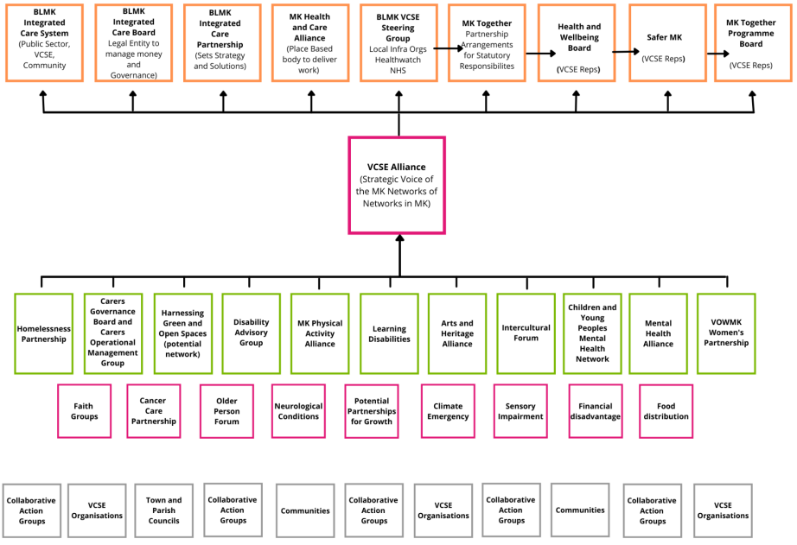

Slide 17
Connecting Health Communities
Facilitation support from IVAR through Building Health Partnerships programme (now CHC)
2 workshops with the VCSE sector to explore an alliance
2 workshops to a mixed audience of professionals to explore joint working on health inequalities
Triangulation not duplication
Represent collective interests
Shared values
Flexible architecture
Continuous learning

Slide 18
What next?
In the chat:
What resonated with you from the session?
Download resources and learning products:
Innovation Unit Resources page
IVAR Resources page
The King’s Fund project page
Join the conversation on Twitter
@InnovationUnit @TNLComFund @IVAR_UK @TheKingsFund
Keep and eye out for blogs and resources coming soon

